Slide 1

Using Software Modules — Welcome to Hell!

Slide 2

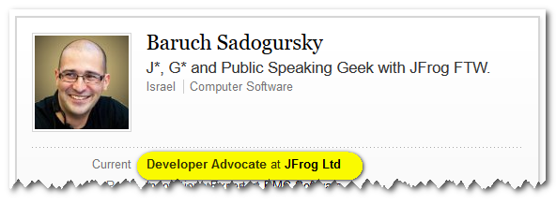
About your speaker
@jbaruch
github.com/jbaruch
linkd.in/jbaruch
stackoverflow.com/users/402053/jbaruch
Notes:
CURRENT – JB NEXT - YOAV

Slide 3
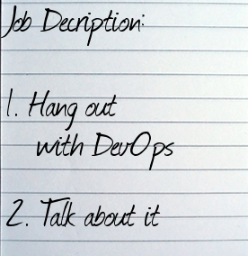
Developer who?

Slide 4
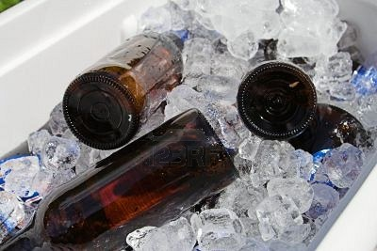
Developer who?

Slide 5
What Frog?

Slide 6
What Frog?

Slide 7
What Frog?

Slide 8

What Frog?

Slide 9


Slide 10


Slide 11


Slide 12


Slide 13

Agenda
181 slides
40 memes

Slide 14
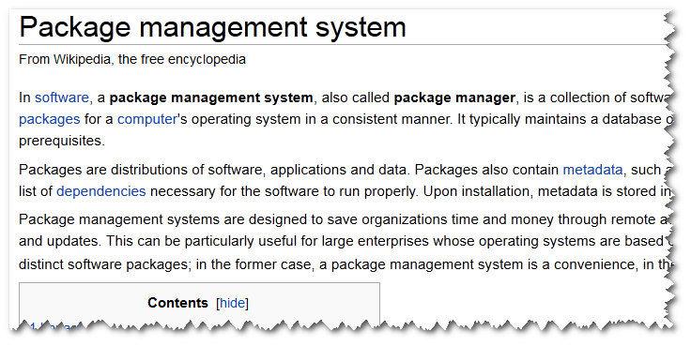

Slide 15

TL;DR
Notes:
Scary? We won’t read it.

Slide 16
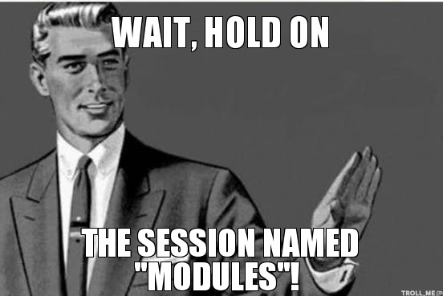

Slide 17
Packages & Modules
Modules | Packages

Slide 18
Packages & Modules
Modules | Packages
API development

Slide 19
Packages & Modules
Modules | Packages
API development | Installable runtime

Slide 20

For the sake of this talk

Slide 21
Modules, modules, modules

Slide 22
Modules, modules, modules
System | dpkg, RPM, tgz, pacman, ipkg, pkgutils, PETget, Upkg, PISI, nix, Equo, Conary, tazpkg, App Store, MacPorts, fink, Homebrew, Google Play, GetJar, Amazon Appstore, Cygwin, Npackd, Steam, Chocolately, NSIS, IPS, Docker, Vagrant

Slide 23
Modules, modules, modules
System | dpkg, RPM, tgz, pacman, ipkg, pkgutils, PETget, Upkg, PISI, nix, Equo, Conary, tazpkg, App Store, MacPorts, fink, Homebrew, Google Play, GetJar, Amazon Appstore, Cygwin, Npackd, Steam, Chocolately, NSIS, IPS, Docker, Vagrant

Slide 24
Modules, modules, modules
System | dpkg, RPM, App Store, Homebrew, Google Play, Steam, Docker, Vagrant

Slide 25
Modules, modules, modules
System | dpkg, RPM, App Store, Homebrew, Google Play, Steam, Docker, Vagrant
Dev. | Cabal, Composer, CPAN, CRAN, Python eggs, Ivy, Maven, Gradle, sbt, leiningen, PyPI, NuGet, RubyGems, Quicklisp, CocoaPods

Slide 26
Modules, modules, modules
System | dpkg, RPM, App Store, Homebrew, Google Play, Steam, Docker, Vagrant
Dev. | Cabal, Composer, CPAN, CRAN, Python eggs, Ivy, Maven, Gradle, sbt, leiningen, PyPI, NuGet, RubyGems, Quicklisp, CocoaPods

Slide 27
Modules, modules, modules
System | dpkg, RPM, App Store, Homebrew, Google Play, Steam, Docker, Vagrant
Dev. | Ivy, Maven, Gradle, sbt, PyPI, NuGet, RubyGems, CocoaPods

Slide 28
Modules, modules, modules
System | dpkg, RPM, App Store, Homebrew, Google Play, Steam, Docker, Vagrant
Dev. | Ivy, Maven, Gradle, sbt, PyPI, NuGet, RubyGems, CocoaPods
Framework | RoR, Grails, jQuery, Node.js, Spring Roo, JBoss Forge, Play, Chef, Puppet, Eclipse, Docker

Slide 29
Modules, modules, modules
System | dpkg, RPM, App Store, Homebrew, Google Play, Steam, Docker, Vagrant
Dev. | Ivy, Maven, Gradle, sbt, PyPI, NuGet, RubyGems, CocoaPods
Framework | RoR, Grails, jQuery, Node.js, Spring Roo, JBoss Forge, Play, Chef, Puppet, Eclipse, Docker, Vagrant

Slide 30
Modules, modules, modules
System | dpkg, RPM, App Store, Homebrew, Google Play, Steam, Docker, Vagrant
Dev. | Ivy, Maven, Gradle, sbt, PyPI, NuGet, RubyGems, CocoaPods
Framework | RoR, Grails, jQuery, Node.js, Spring Roo, Chef, Puppet, Eclipse

Slide 31
Modules, modules, modules
System | dpkg, RPM, App Store, Homebrew, Google Play, Steam, Docker, Vagrant
Dev. | Ivy, Maven, Gradle, sbt, PyPI, NuGet, RubyGems, CocoaPods
Framework | RoR, Grails, jQuery, Node.js, Spring Roo, Chef, Puppet, Eclipse
Application | Any pluggable application!

Slide 32
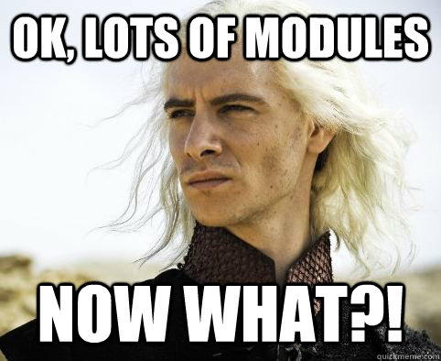

Slide 33
Dragon stories ahead!
fACDdb

Slide 34
Story Number one
f

Slide 35
, A Story of indexes +

Slide 36
, A Story of indexes +
< Kept in wrong place >

Slide 37
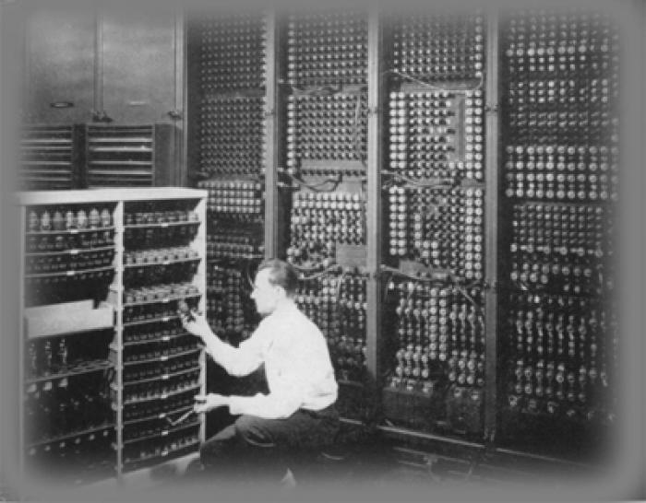
Once Upon A Time…

Slide 38
Once Upon A Time…
Can’t serve… searches…

Slide 39
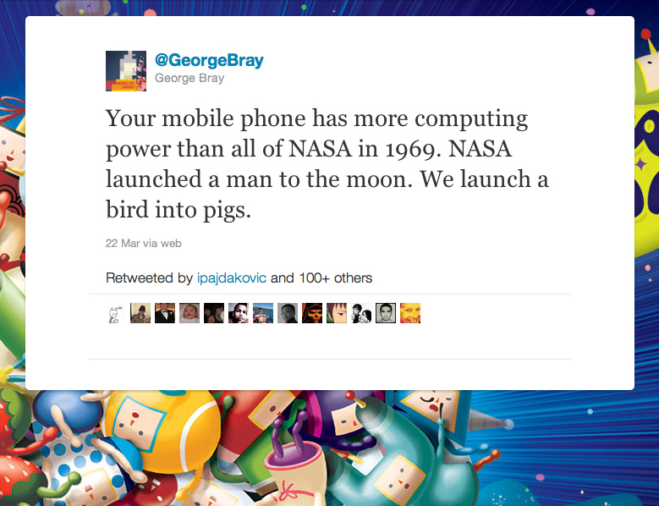
Not anymore…

Slide 40

Look ma, no index download!

Slide 41
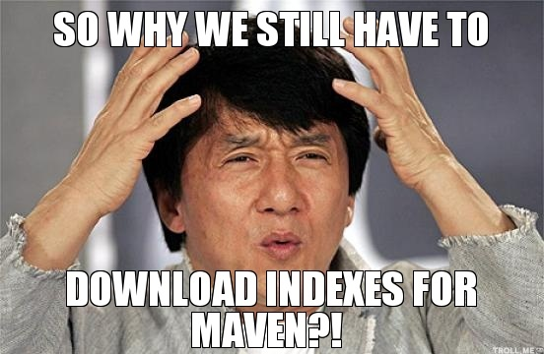

Slide 42
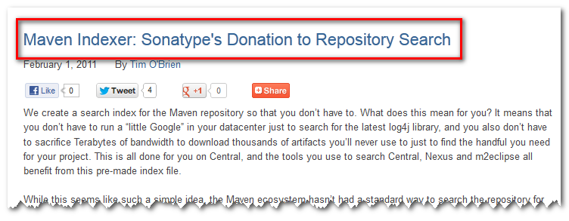

Slide 43


Slide 44
Have to download huge files Before Searching

Slide 45
Have to download huge files Before Searching
Updated rarely

Slide 46
Have to download huge files Before Searching
Updated rarely
Requires special client

Slide 47

Have to download huge files Before Searching
Updated rarely
Requires special client
F-

Slide 49


Slide 50

Who’s good, who’s not?
NuGet
RubyGems
PyPi
Docker
Vagrant
Deb
RPM
Maven CocoaPods

Slide 51
Who’s good, who’s not?
Good Excuse: old tools
NuGet
RubyGems
PyPi
Docker
Vagrant
Deb
RPM
Maven CocoaPods

Slide 52

Lesson learned
Index on the server-side, expose query API

Slide 53
Story Number Two
A

Slide 54


Slide 55
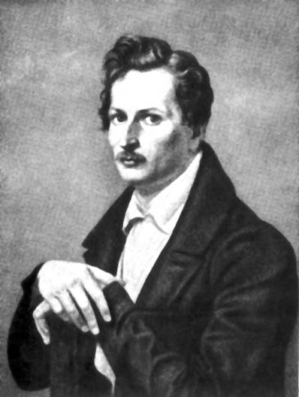
Heinrich Heine

Slide 56
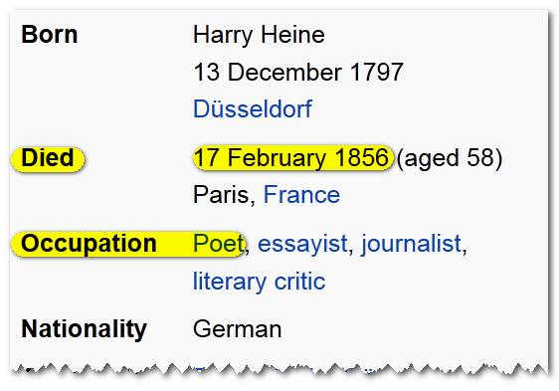
Heinrich Heine

Slide 57
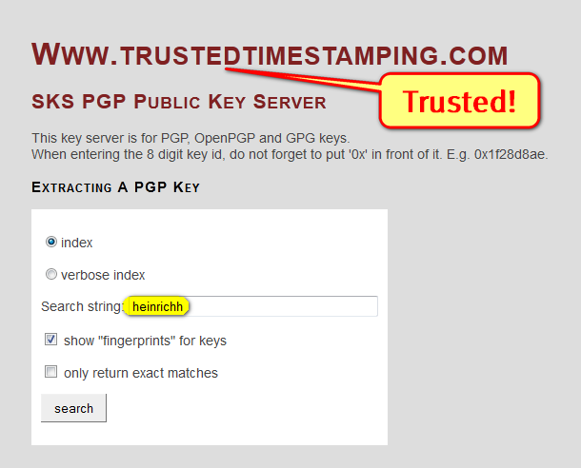

Slide 58
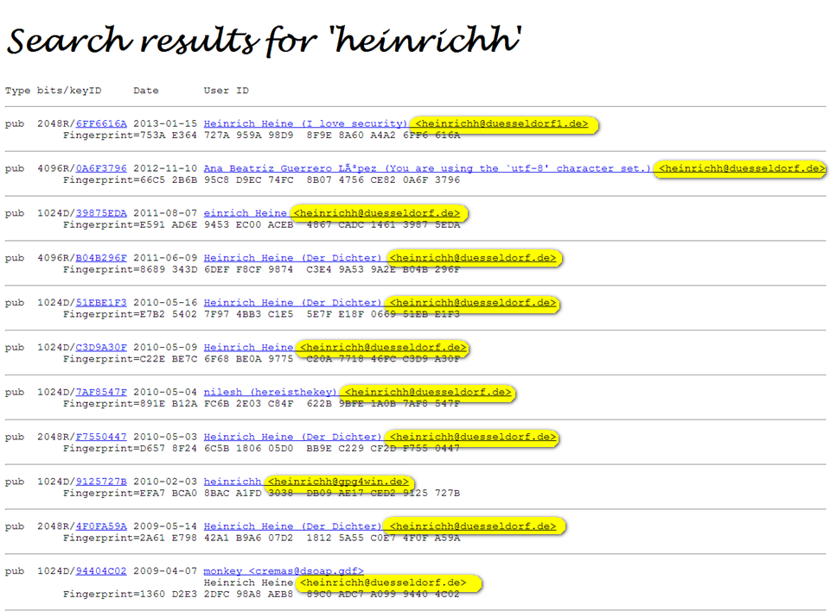

Slide 59
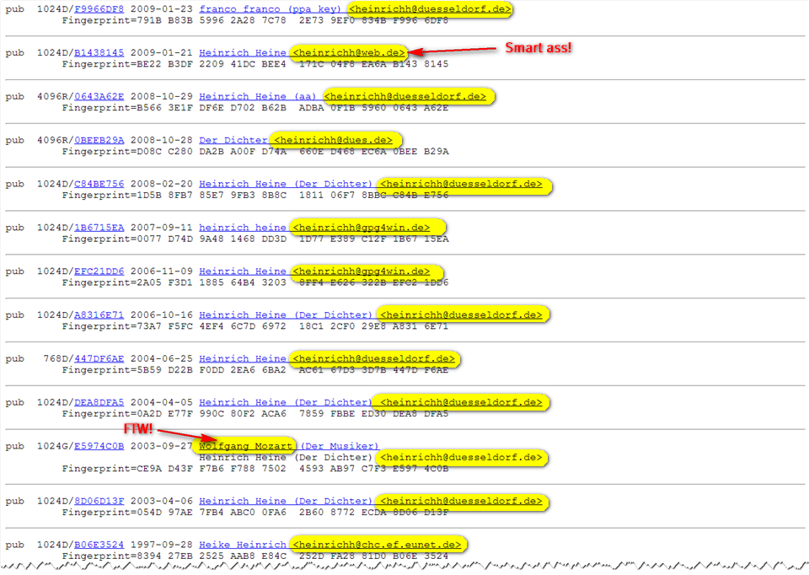

Slide 60
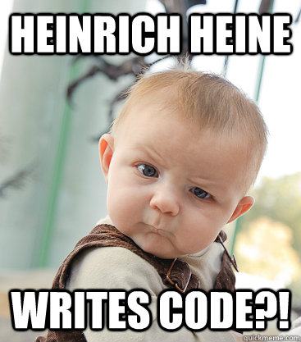

Slide 61


Slide 62
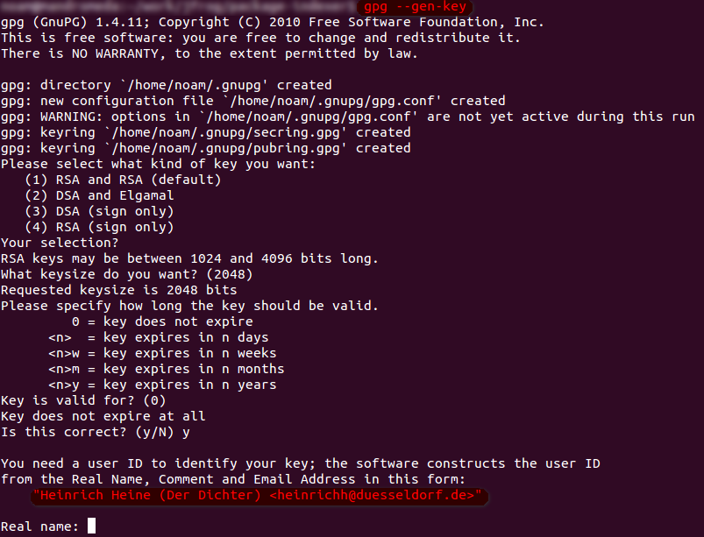

Slide 63
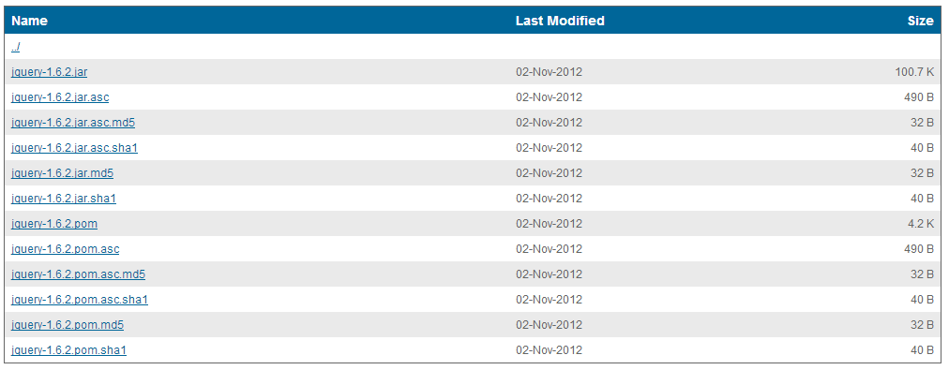

Slide 64


Slide 65
Story Number Two (and a half)
AA

Slide 66
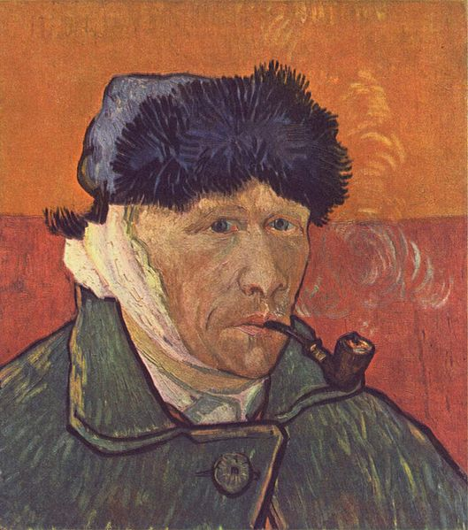
He cut his ear off and died unappreciated

Slide 67
Lesson learned
Authenticate by public identity;
Give credit to the developer

Slide 68


Slide 69
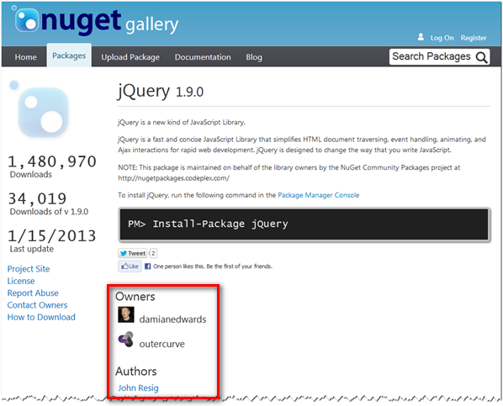
Identified, credited. Well Done.

Slide 70


Slide 71
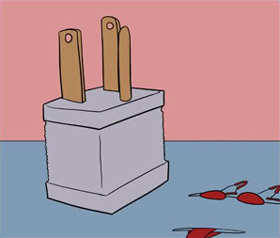

Slide 72
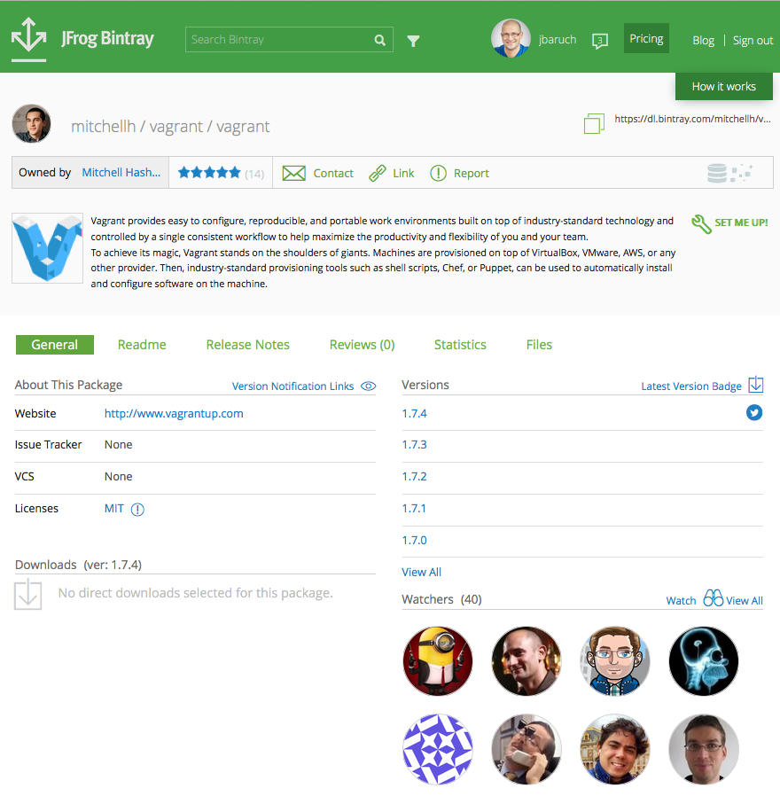

Slide 73
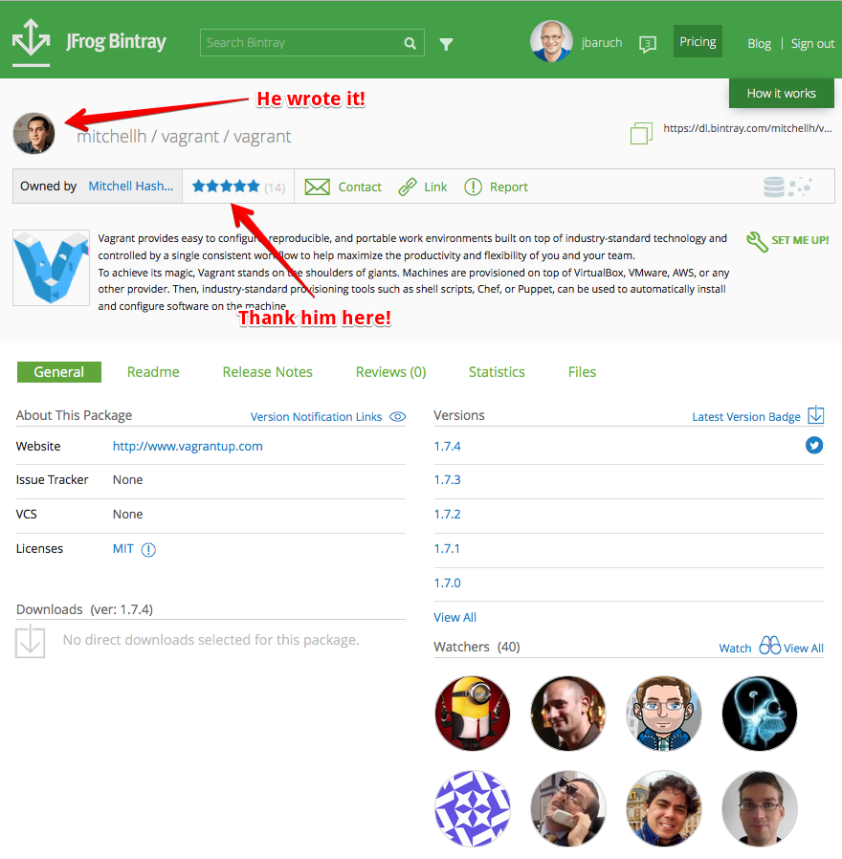

Slide 74




Slide 75
Story Number Three
C

Slide 76
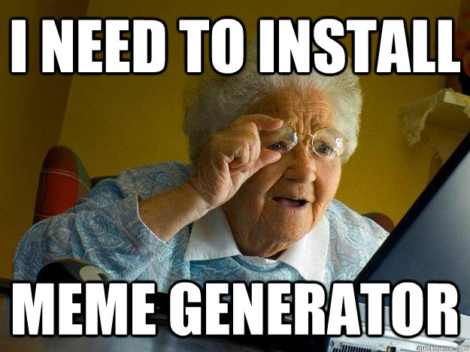
Imagine a typical windows user

Slide 77
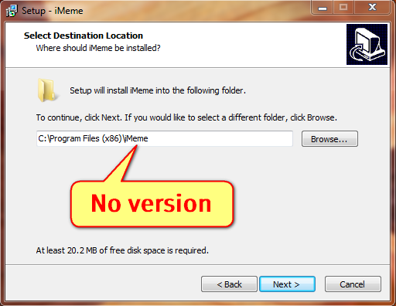

Slide 78
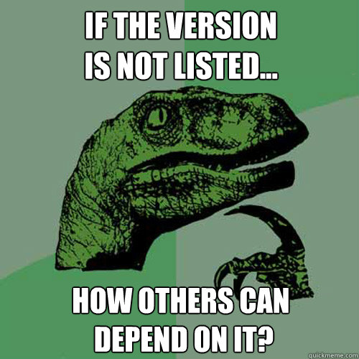

Slide 79
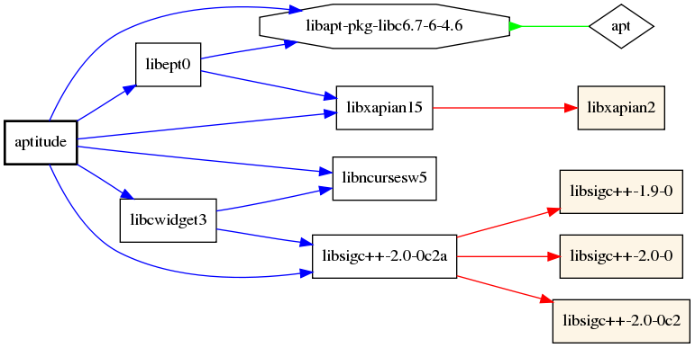
Depending on name only

Slide 80
Depending on name only
Where’s the version, dude?!

Slide 81

Time for the boromir Meme!
You knew it is coming!

Slide 82
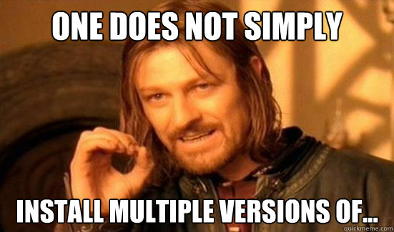

Slide 83
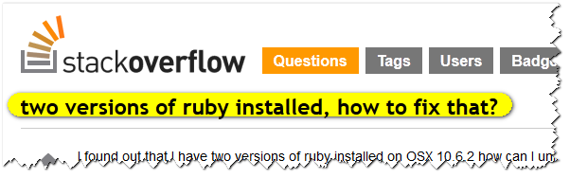

Slide 84
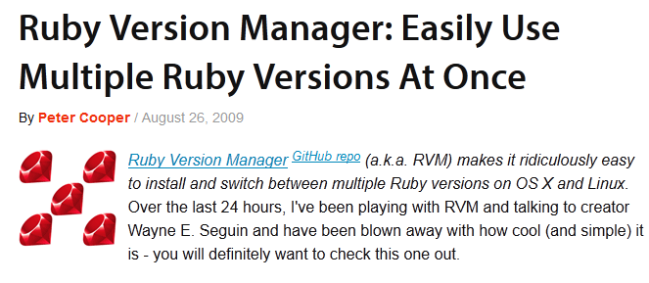

Slide 85
Single Namespace Troubles
Scope | Trouble | Examples | Work-around

Slide 86
Single Namespace Troubles
Scope | Trouble | Examples | Work-around
System | Can’t use multiple versions, update all

Slide 87
Single Namespace Troubles
Scope | Trouble | Examples | Work-around
System | Can’t use multiple versions, update all | RPMs, Ruby, Groovy

Slide 88
Single Namespace Troubles
Scope | Trouble | Examples | Work-around
System | Can’t use multiple versions, update all | RPMs, Ruby, Groovy | RVM, GVM, Homebrew

Slide 89
Single Namespace Troubles
Scope | Trouble | Examples | Work-around
System | Can’t use multiple versions, update all | RPMs, Ruby, Groovy | RVM, GVM, Homebrew
Platform | Classpath/ DLL hell

Slide 90
Single Namespace Troubles
Scope | Trouble | Examples | Work-around
System | Can’t use multiple versions, update all | RPMs, Ruby, Groovy | RVM, GVM, Homebrew
Platform | Classpath/ DLL hell | Transitive dependency conflicts

Slide 91
Single Namespace Troubles
Scope | Trouble | Examples | Work-around
System | Can’t use multiple versions, update all | RPMs, Ruby, Groovy | RVM, GVM, Homebrew
Platform | Classpath/ DLL hell | Transitive dependency conflicts | Uberjar /Static compilation

Slide 92

Interlude…

Slide 93
Maven’s Conflict Manager
A v1

Slide 94
Maven’s Conflict Manager
A v1
E v1

Slide 95
Maven’s Conflict Manager
A v1
E v1
D v1

Slide 96
Maven’s Conflict Manager
A v1
E v1
B v1
D v1

Slide 97
Maven’s Conflict Manager
A v1
E v1
B v1
D v1
C v1

Slide 98
Maven’s Conflict Manager
A v1
E v1
B v1
D v1
C v1
D v2

Slide 99
Maven’s Conflict Manager
A v1
E v1
B v1
D v1
C v1
D v2

Slide 100
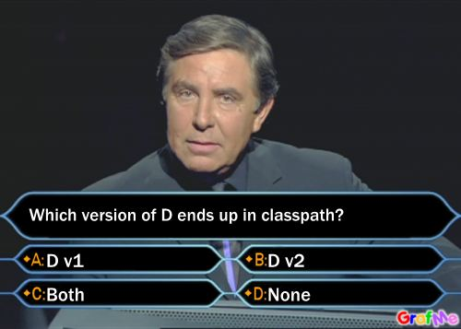
Maven’s Conflict Manager

Slide 101
Maven’s Conflict Manager
T-shirt for knowing the answer (and why)!

Slide 102
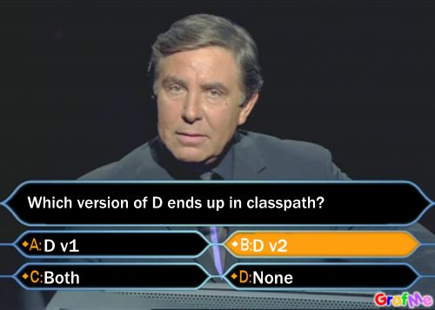
Maven’s Conflict Manager

Slide 103
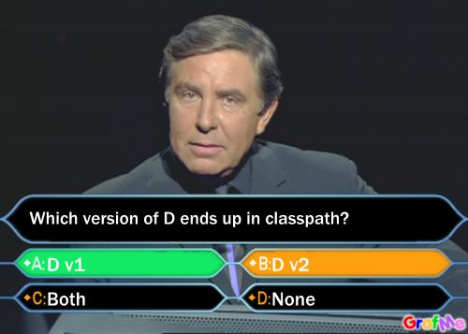
Maven’s Conflict Manager

Slide 104


Slide 105
Boromir Returns!
Reprise…

Slide 106
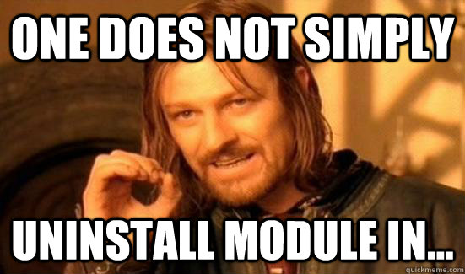

Slide 107
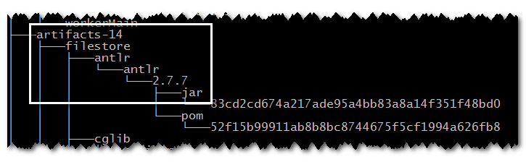

Slide 108
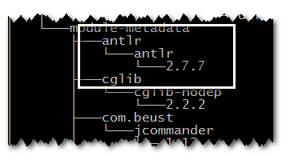

Slide 109
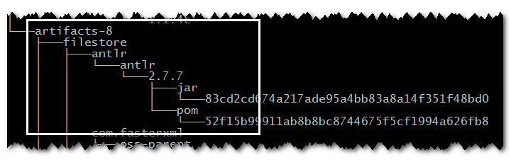

Slide 110

Just not very usable…

Slide 111
Lesson learned
Provide isolation and cache manager

Slide 112
Story Number Four
g

Slide 113
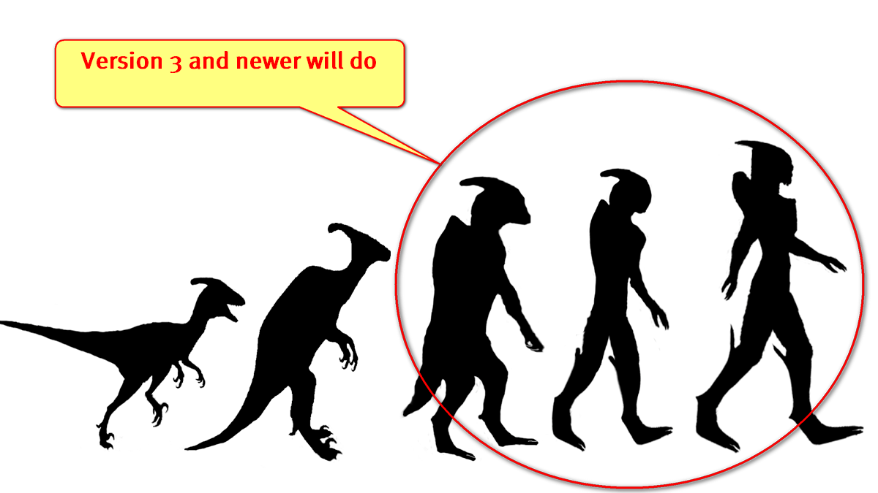
Version ranges

Slide 114
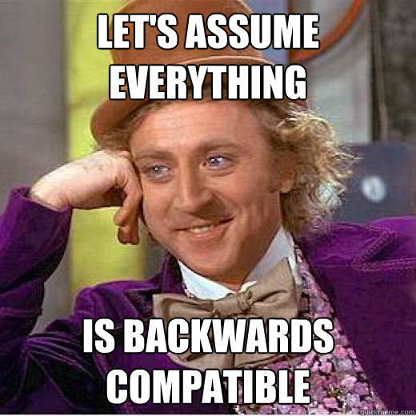

Slide 115


Slide 116

Stuff Suddenly stops working

Slide 117

Competition for the fragilest dependency management ever!

Slide 118
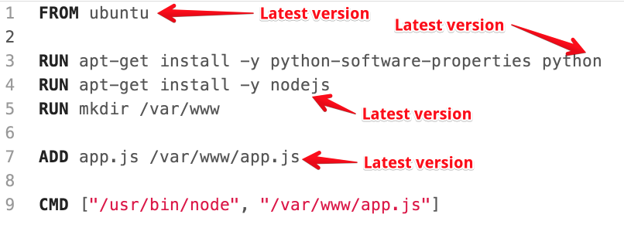
And the winner is…

Slide 119

Whole new meaning to “The Fail Whale”
*we know it’s a seal, but whale would do a facepalm too if his fins were long enough

Slide 120
Lesson learned
Require explicit dependency versions

Slide 121
Story Number Five
D

Slide 122
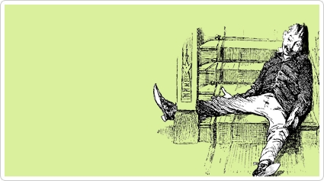
Like vodka and beer…

Slide 123
…Config. and Metadata…

Slide 124
…Just won’t mix.

Slide 125
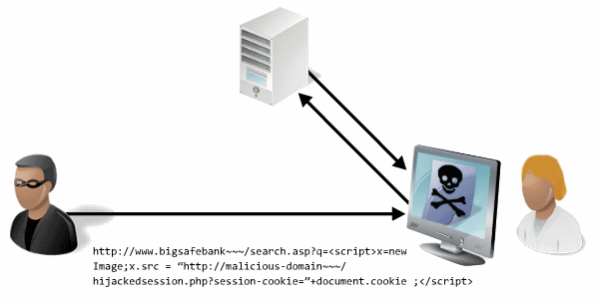
a.k.a dependency management xss

Slide 126
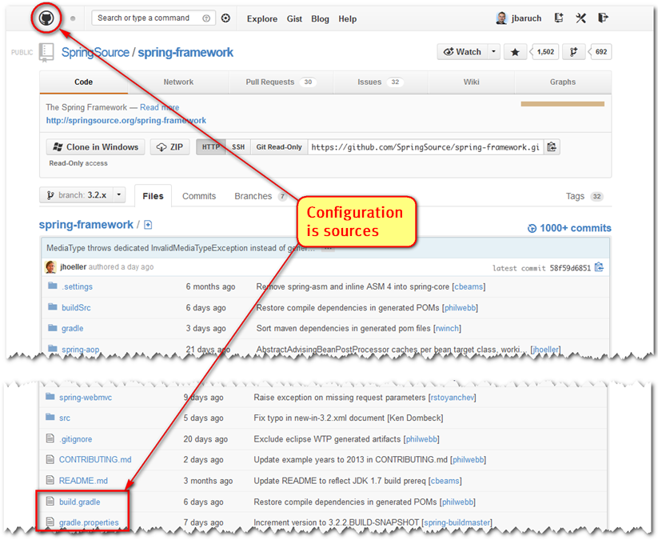

Slide 127
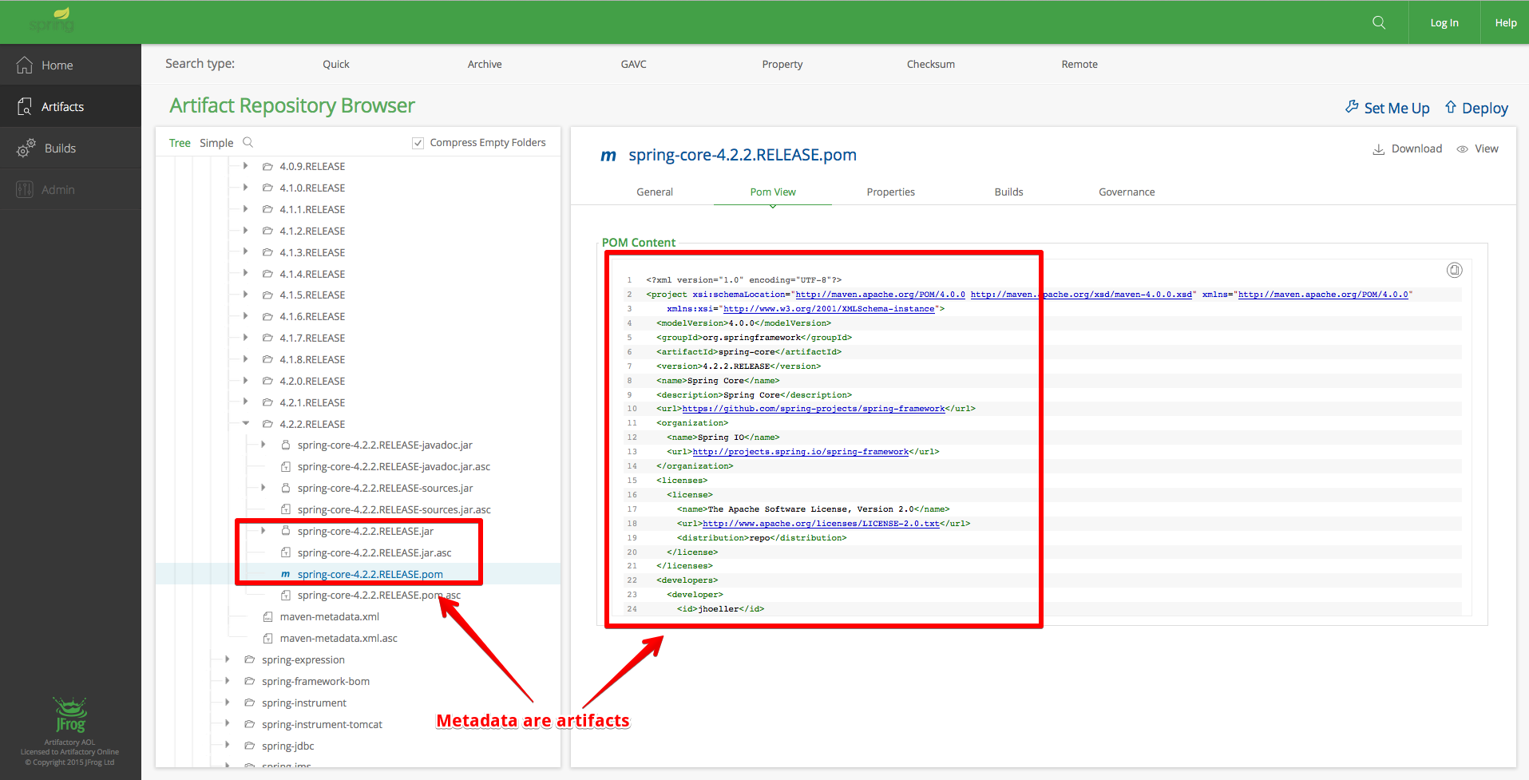

Slide 128

So, a user had a project…

Slide 129
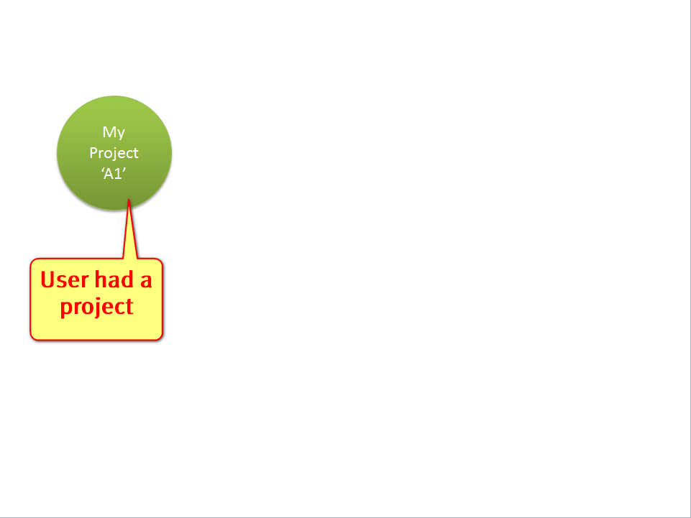

Slide 130
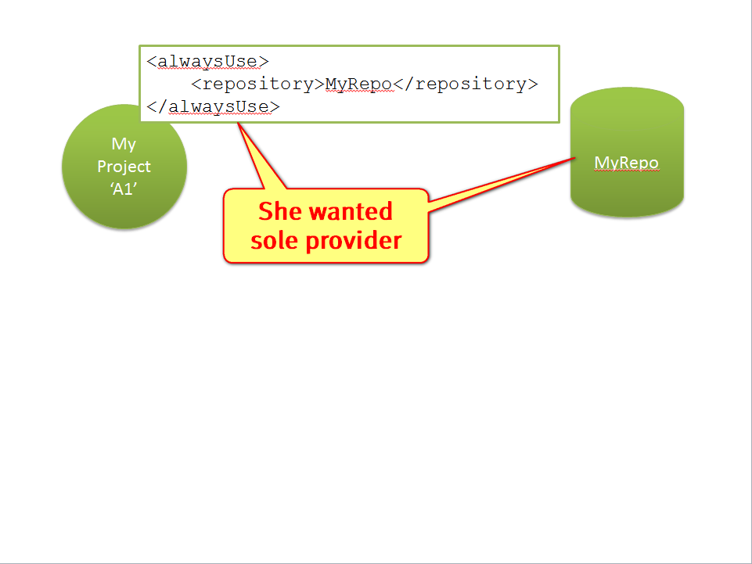
<alwaysUse> <repository>MyRepo</repository> </alwaysUse>

Slide 131
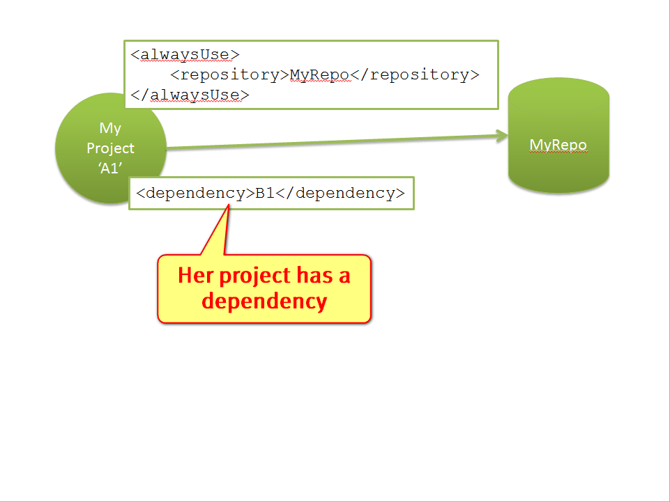

Slide 132
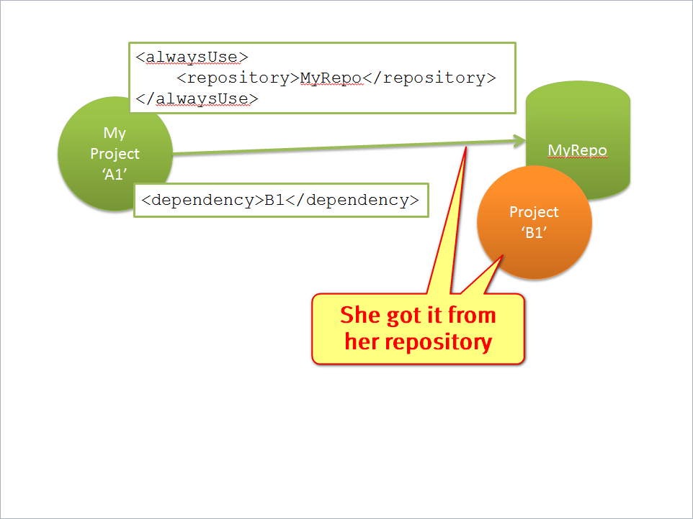

Slide 133
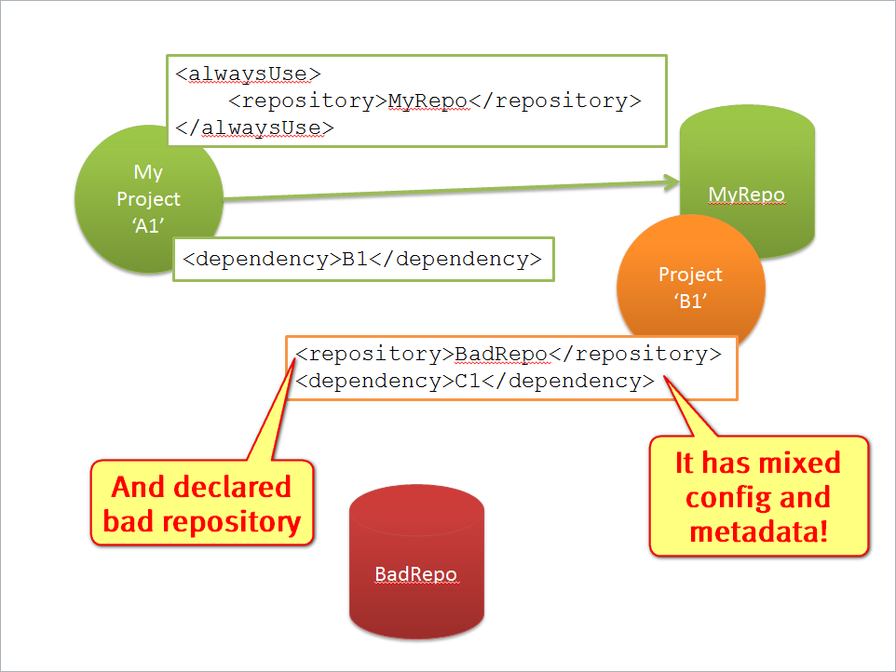

Slide 134


Slide 135
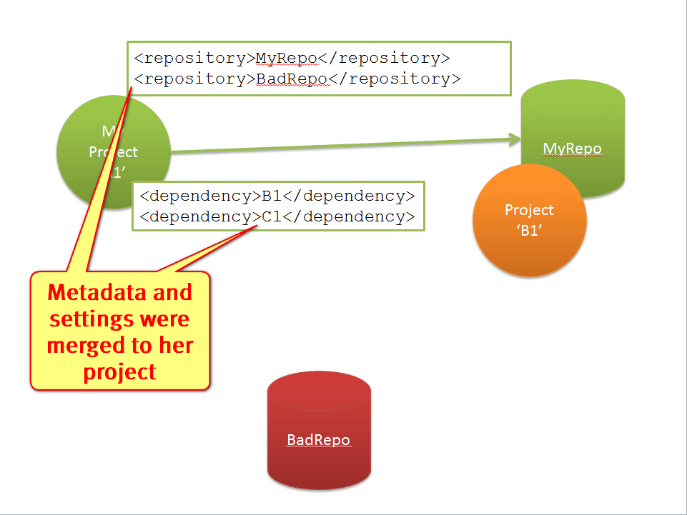

Slide 136


Slide 137


Slide 138

By now you might think we have a Maven bias. Here you go:

Slide 139
So, a user wanted to install npm package…

Slide 140
$npm cache clean
$npm config set registry \
http://192.168.99.100:8081/artifactory/api/npm/npm-registry
$npm -d install intern@1.3

Slide 142



Slide 143


Slide 145
Lesson learned
Don’t mix vodka and beer configuration and metadata

Slide 146
Story Number six
a

Slide 147

Trumped-up limitations

Slide 148

The Anatomy of Docker Tag

Slide 149

Wait a second, how can I have more than one repository per host now?!

Slide 150

“One registry per host ought to be enough for anybody.”

Slide 151
Lesson learned
Don’t impose unnecessary limitations (specially in areas outside of core competency)

Slide 152
Story Number seven
c

Slide 153
The wrong memento

Slide 158

Git is the wrong place.
“…frequent problems…because of large files clogging up [Git] repositories, slowing everything down, and making clone sizes intolerable…
https://developer.atlassian.com/blog/2015/10/contributing-to-git-lfs/

Slide 159

I don’t always use in-house repository…
You know what, I actually always do.

Slide 160

Wait, how can I use an in-house repository when GitHub is hardcoded?

Slide 162
Lesson learned
Don’t hardcore a central registry (specially of the incorrect type)

Slide 163
Story Number eight
b

Slide 164

Which witch watch which watch

Slide 165


Slide 166
Which version of plugin

Slide 167
Which version of plugin for which version of elasticsearch

Slide 168
Which version of plugin for which version of elasticsearch works with which version of grails?

Slide 169


Slide 170

Wouldn’t it be dreamy if there was a way to express version compatibility matrix?

Slide 171

Java Community, Shame On You!

Slide 172
Here’s how you do it:

Slide 173

Here’s how you do it:

Slide 174

Here’s how you do it:

Slide 175

Here’s how you do it:

Slide 176

Here’s how you do it:

Slide 177
Lesson learned
Version Dependency isn’t enough
Support dependency matrix

Slide 178
No more stories, One more thingooo
fACDdb

Slide 179

Doc predicts
Notes:
Doc Brown predicts – even more usage of modules in the future!

Slide 180

All you need is cloud

Slide 181

That’s all, Folks!

